Slide 1
Finacial Services
Financial Services Uses In Tanzania

Slide 2
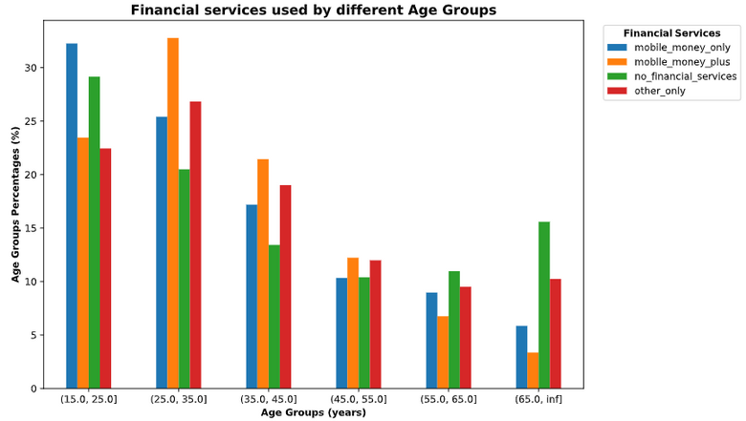
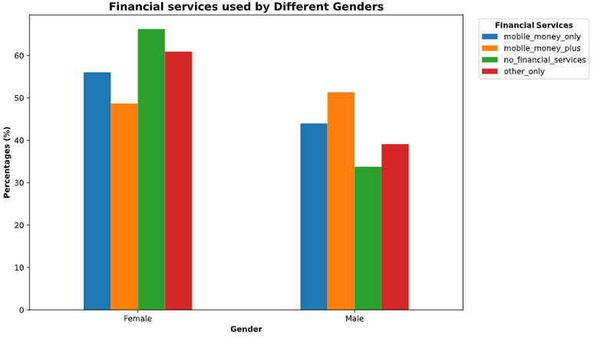
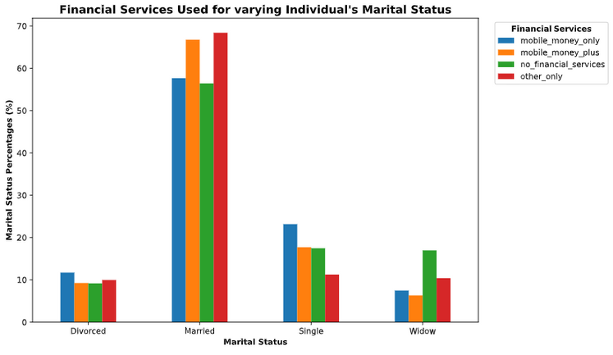
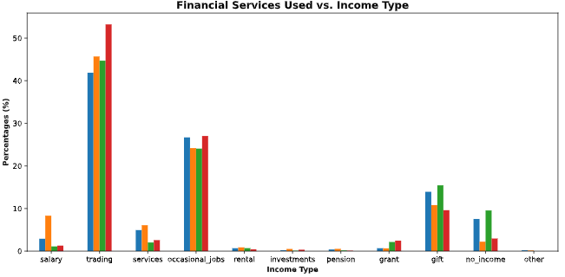
Commentary:
The report represents the financial services uses in Tanzania, the views are based on the FSDT Finscope 2017 survey.
  The financial services usage by age groups suggests that the usage decreases with Age. The age group of 16 to 25 years dominates the no financial services and the mobile money only categories, while the age group 26 to 35 years dominates the mobile money plus and other financial services.
  The financial services used by gender shows that Males are likely to use the mobile money plus, while Females domiates other categories.
  The marital status view shows that Married people are likely to use financial services, than other groups.
  The data shows that majority of financial services users are non land owners.

Slide 3
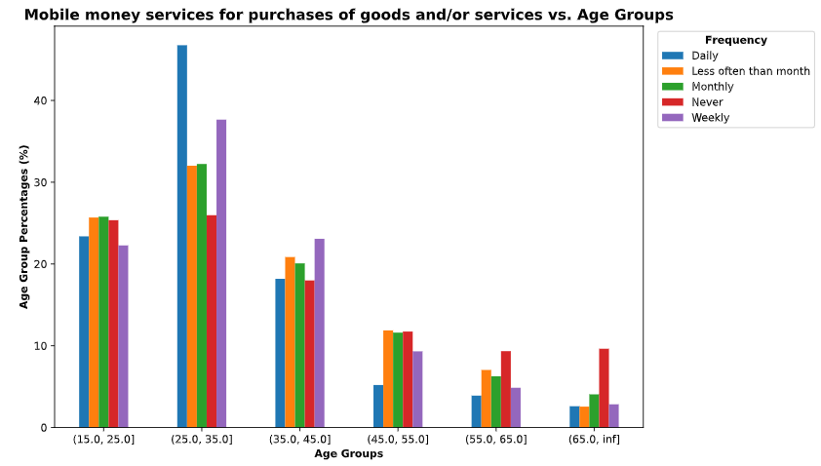
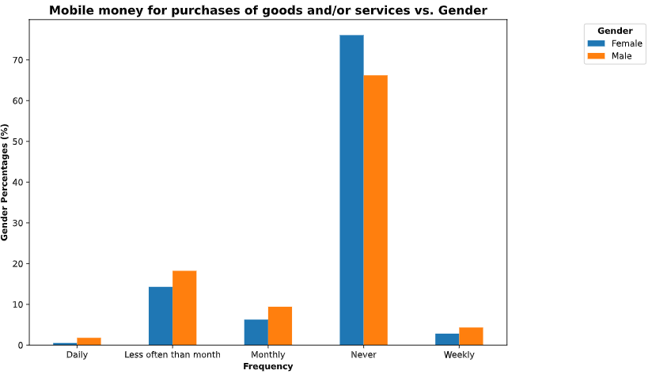
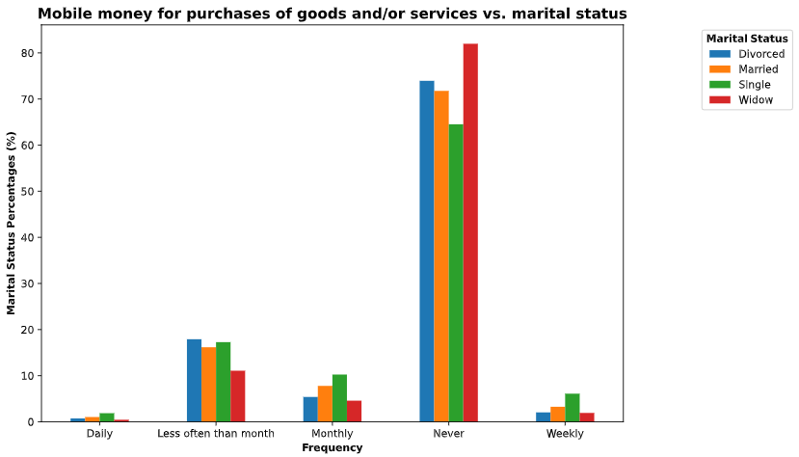
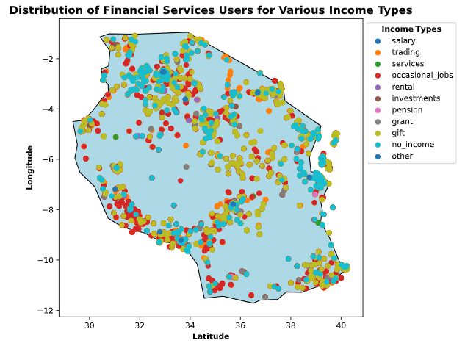
Commentary:
The usage of mobile money services for the purchasing of goods and services shows that:
  For different age groups 26-35 years people are frequent users of the mobile money services. The use of mobile money services peaks at the age group 25-35 years and decreases with increasing age.
  Majority of people never use mobile money services. For those who do, they do that less often than a month, with males being the highest users.
  By marital status, Widows are likely to not use mobile money services while divorced people are likely to use it.
From the income types map.
  The central and eastern region consisting of people who receive gifts as income and no income at all, which are the least financial services users.
  Participants with occasional jobs and traders are distributed across Tanzania, with most located in the western region, along the river. These individuals are the first and second most users of mobile money services

